Slide 1
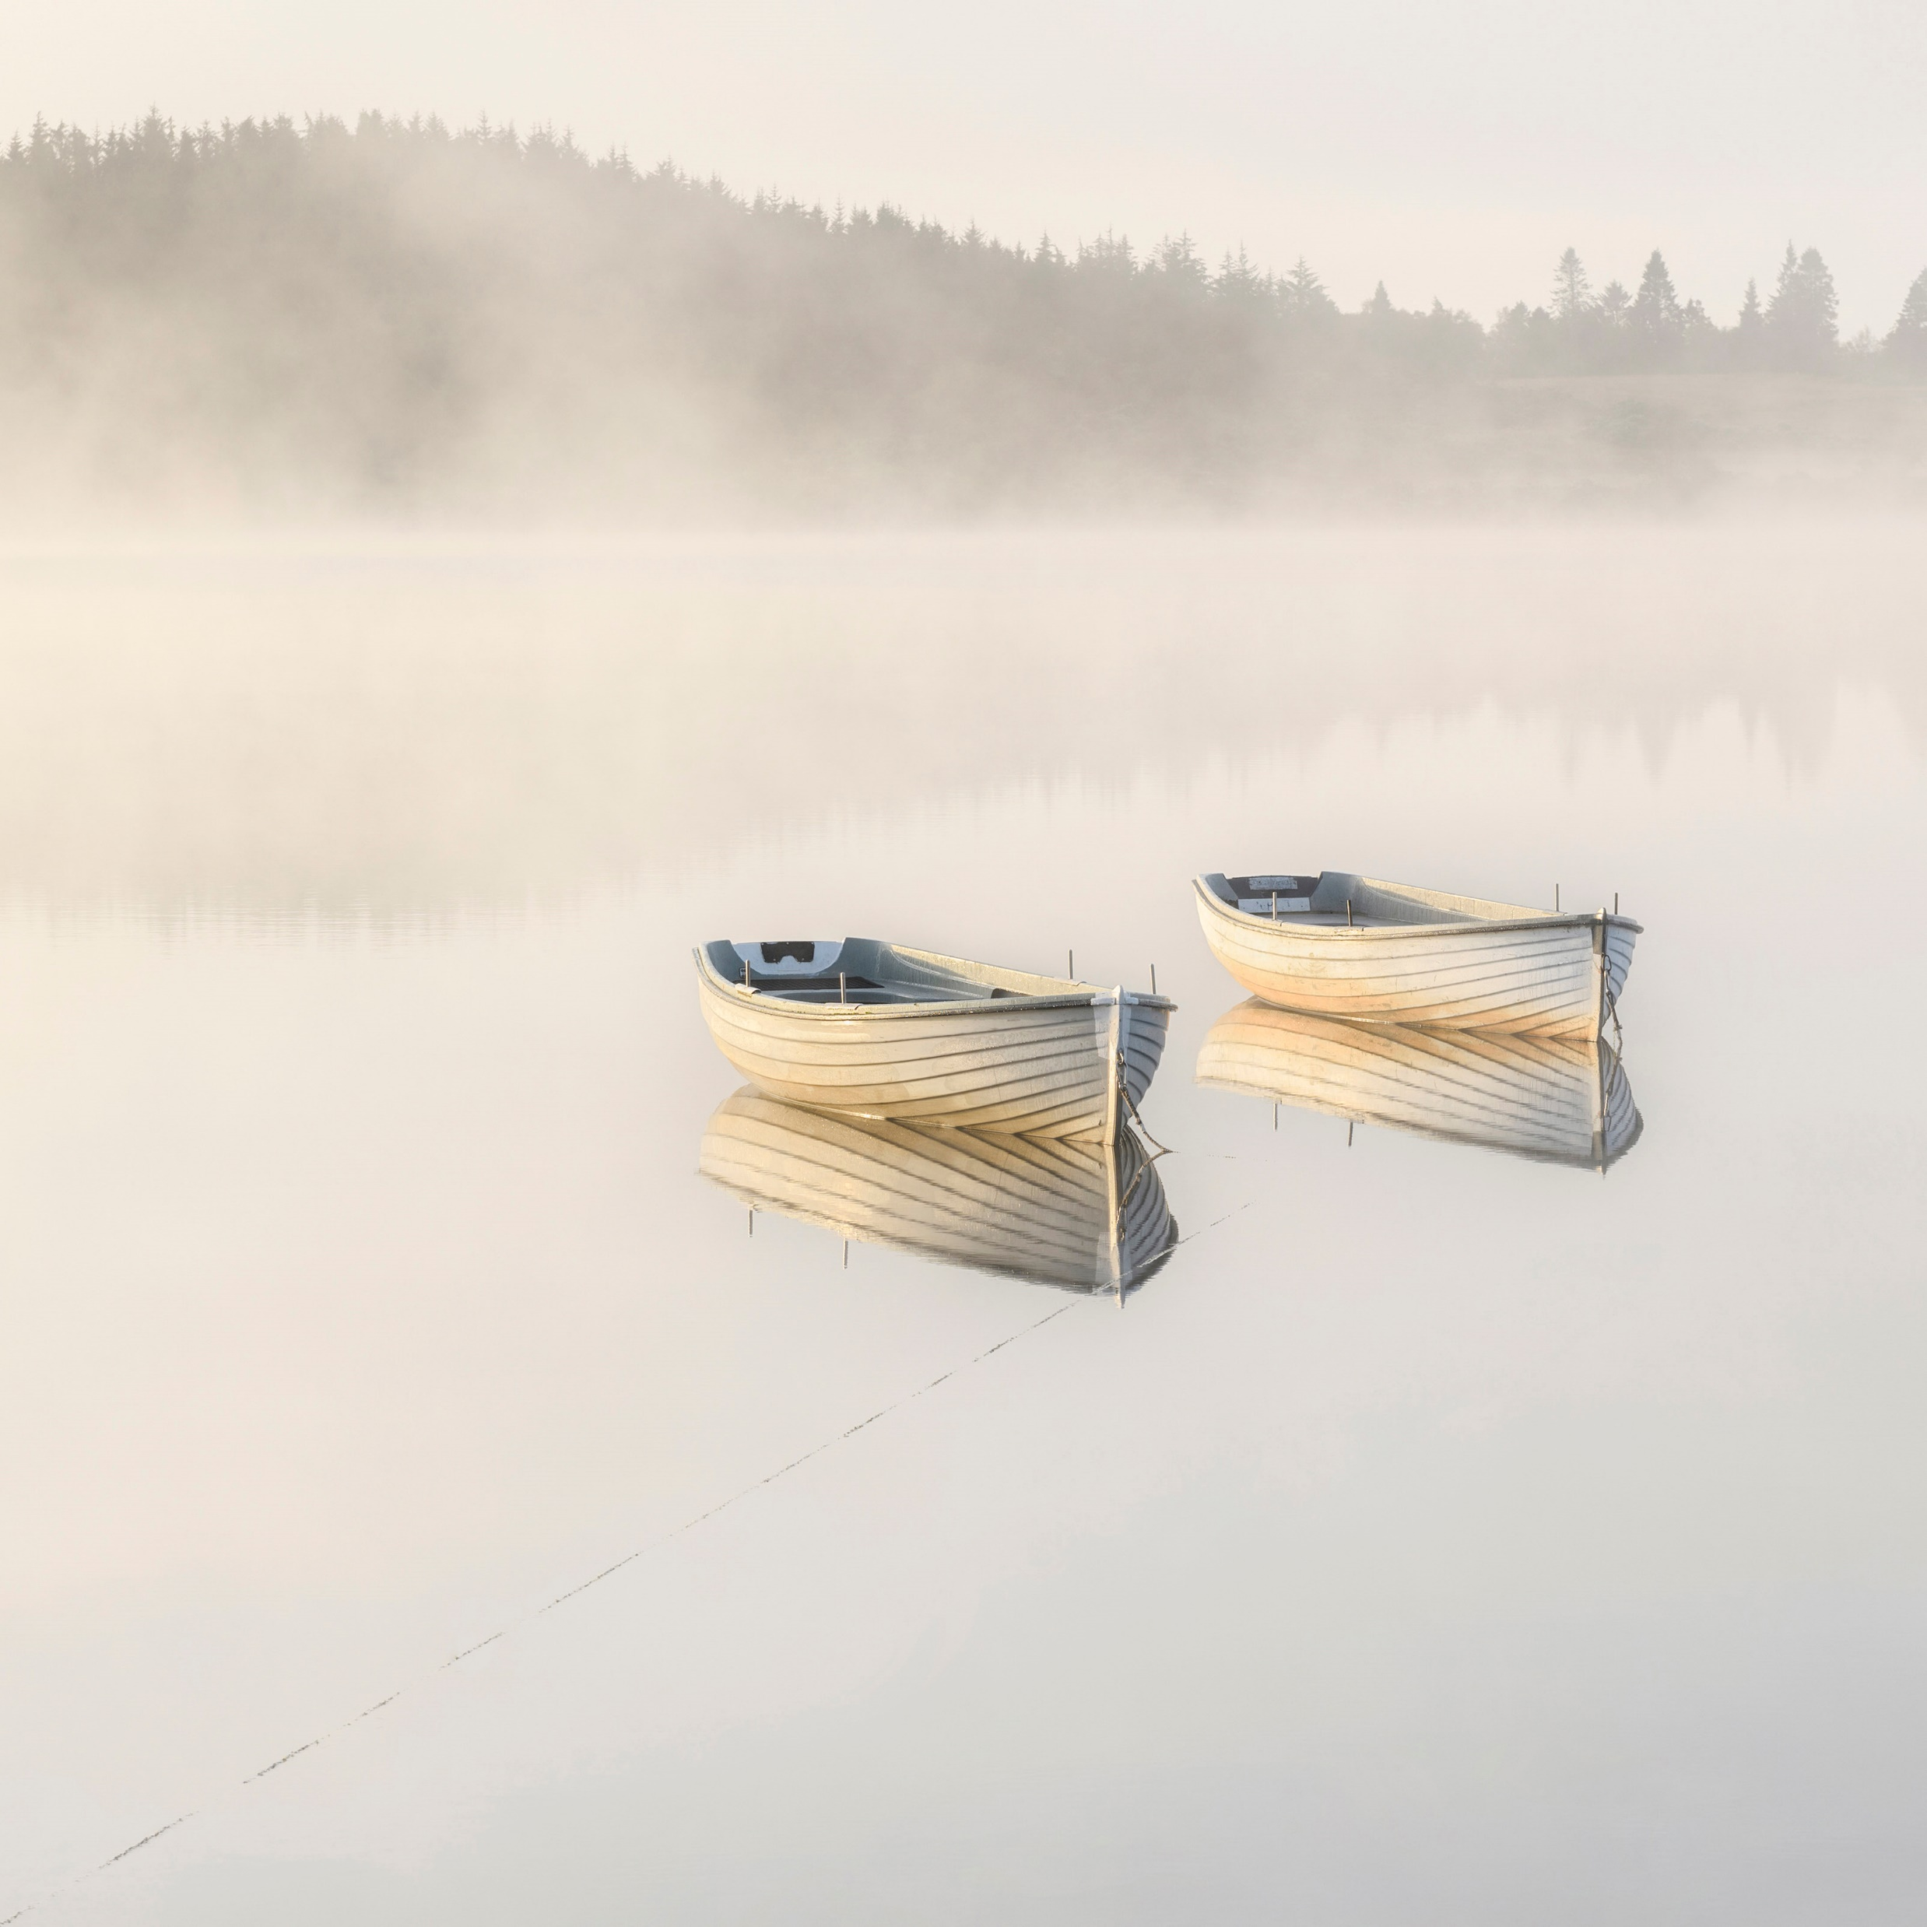
Preparing Printed Images for Competition

Slide 2
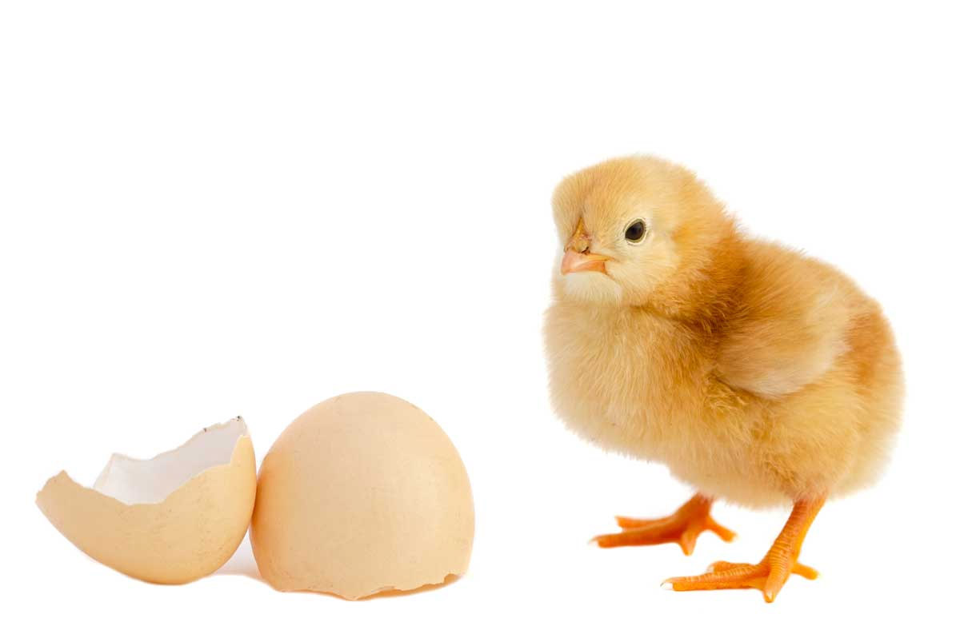
Getting the digital Image Ready – Chicken or Egg
Print to fit mount or mount to fit print

Slide 3
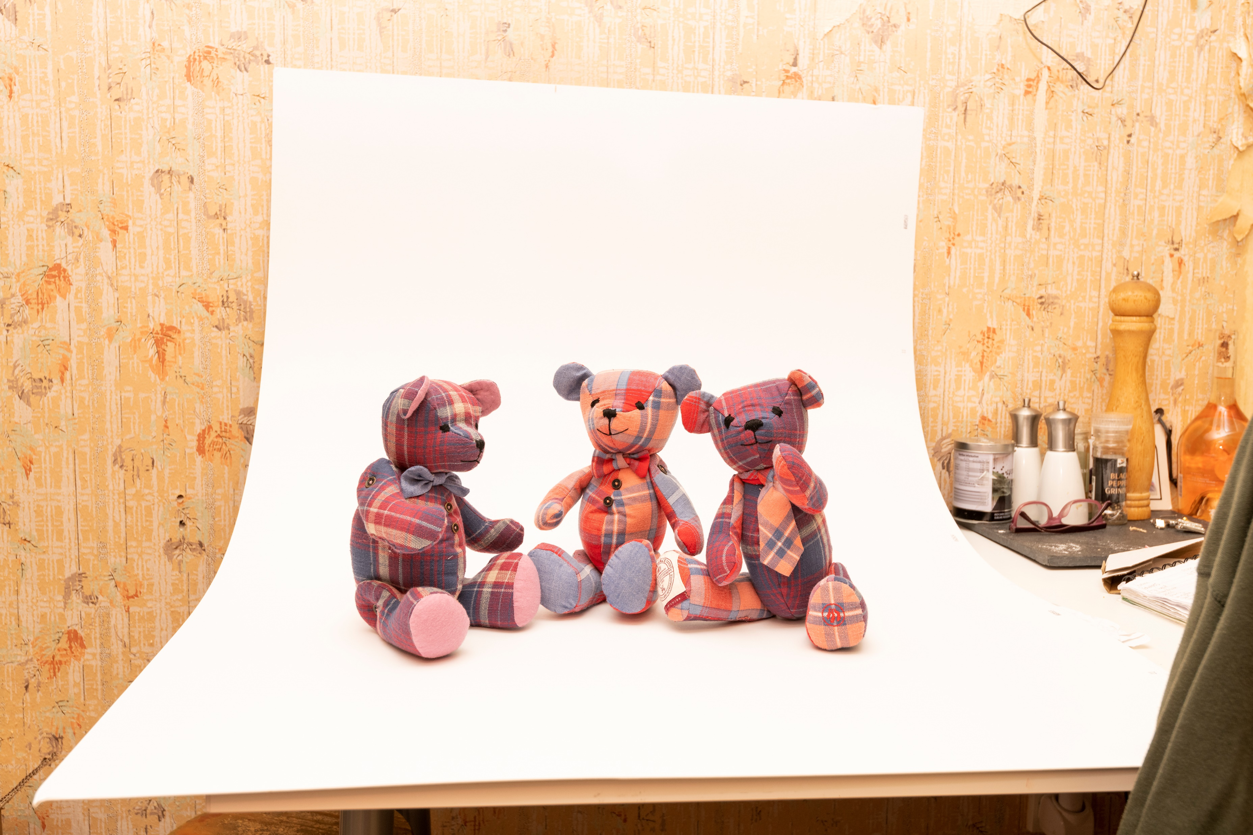
Mount to print – The normal way
Choose the image you want to print and consider the crop you want.
What to consider
Ratio – crop for space or impact with best aesthetics in mind. In a perfect world this would be decided when you shot the image.
Items you want to lose and items you have to keep
Dimensions – Print size determined by resolution and what board you will use as mount
Demo in Photoshop – Ratios and dimensions

Slide 4
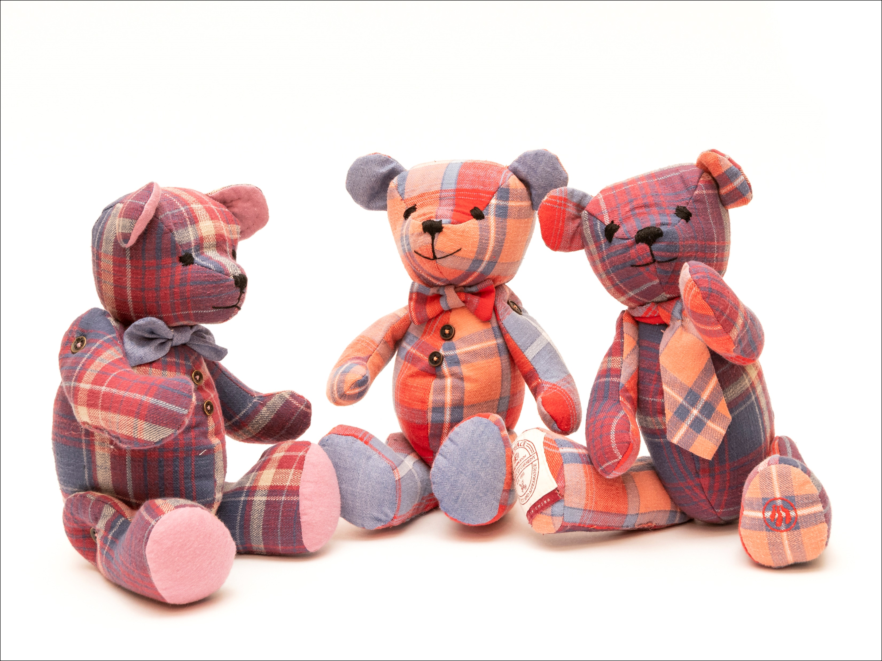
Mount the image
Do the maths
In this case we have a mount 406 x 305 and a print 240 x 180mm so
406 – 240 = 166 /2 = 83mm Vertical Cuts
305 – 180 = 125/2 = 62.5mm Horizontal Cuts
Horizontal cuts for vertical size – Mount horizontal size minus print horizontal size divided by 2 equals measurement for mount cutter
Vertical cuts for horizontal size– Mount vertical size minus print vertical size divided by 2 equals measurement for mount cutter

Slide 5
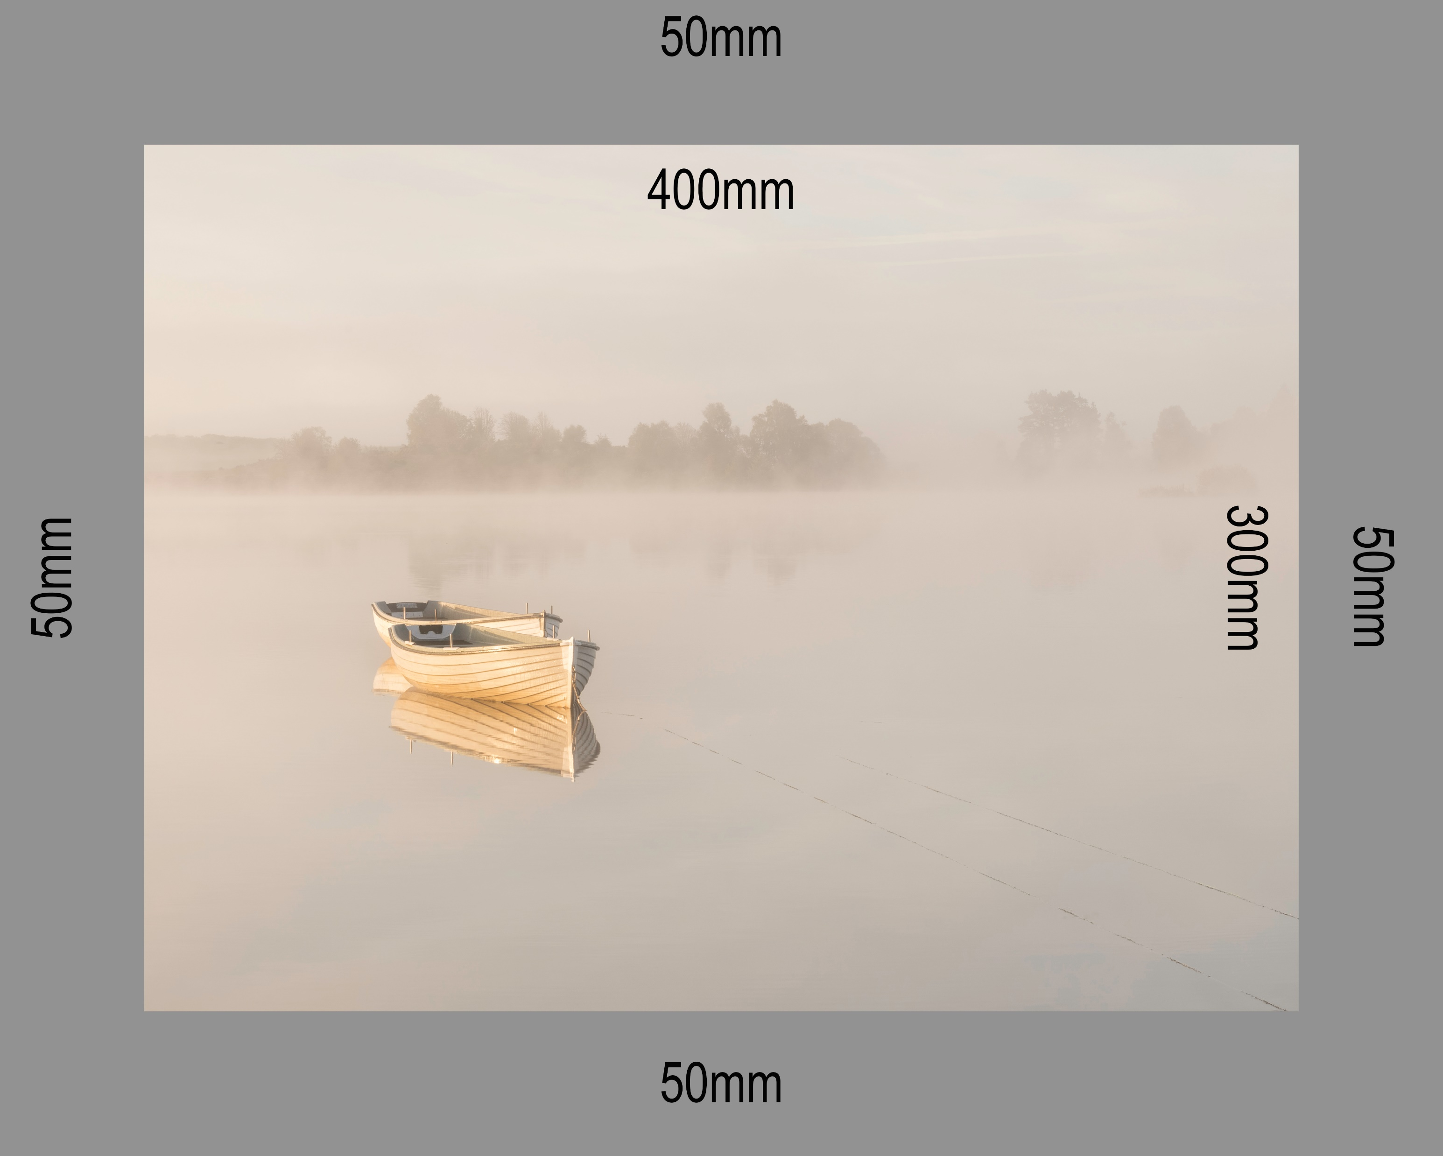
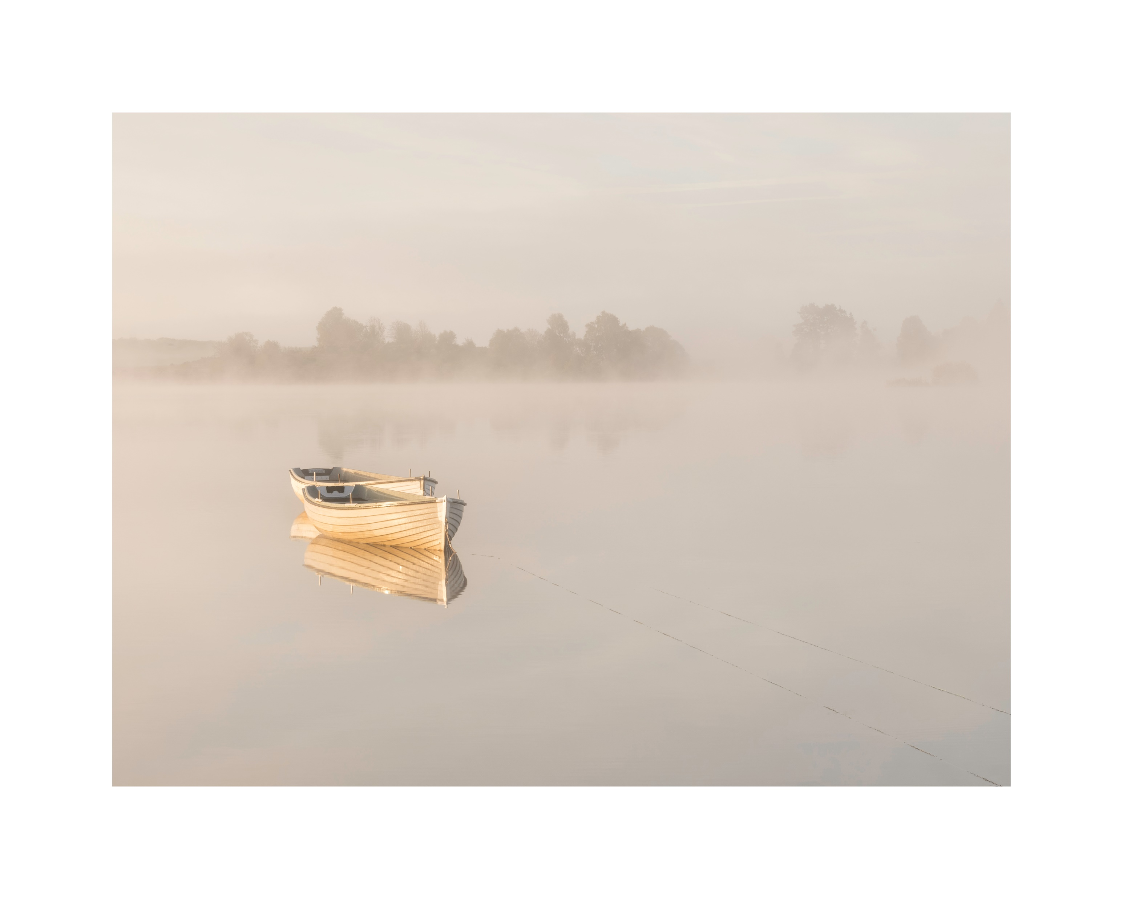
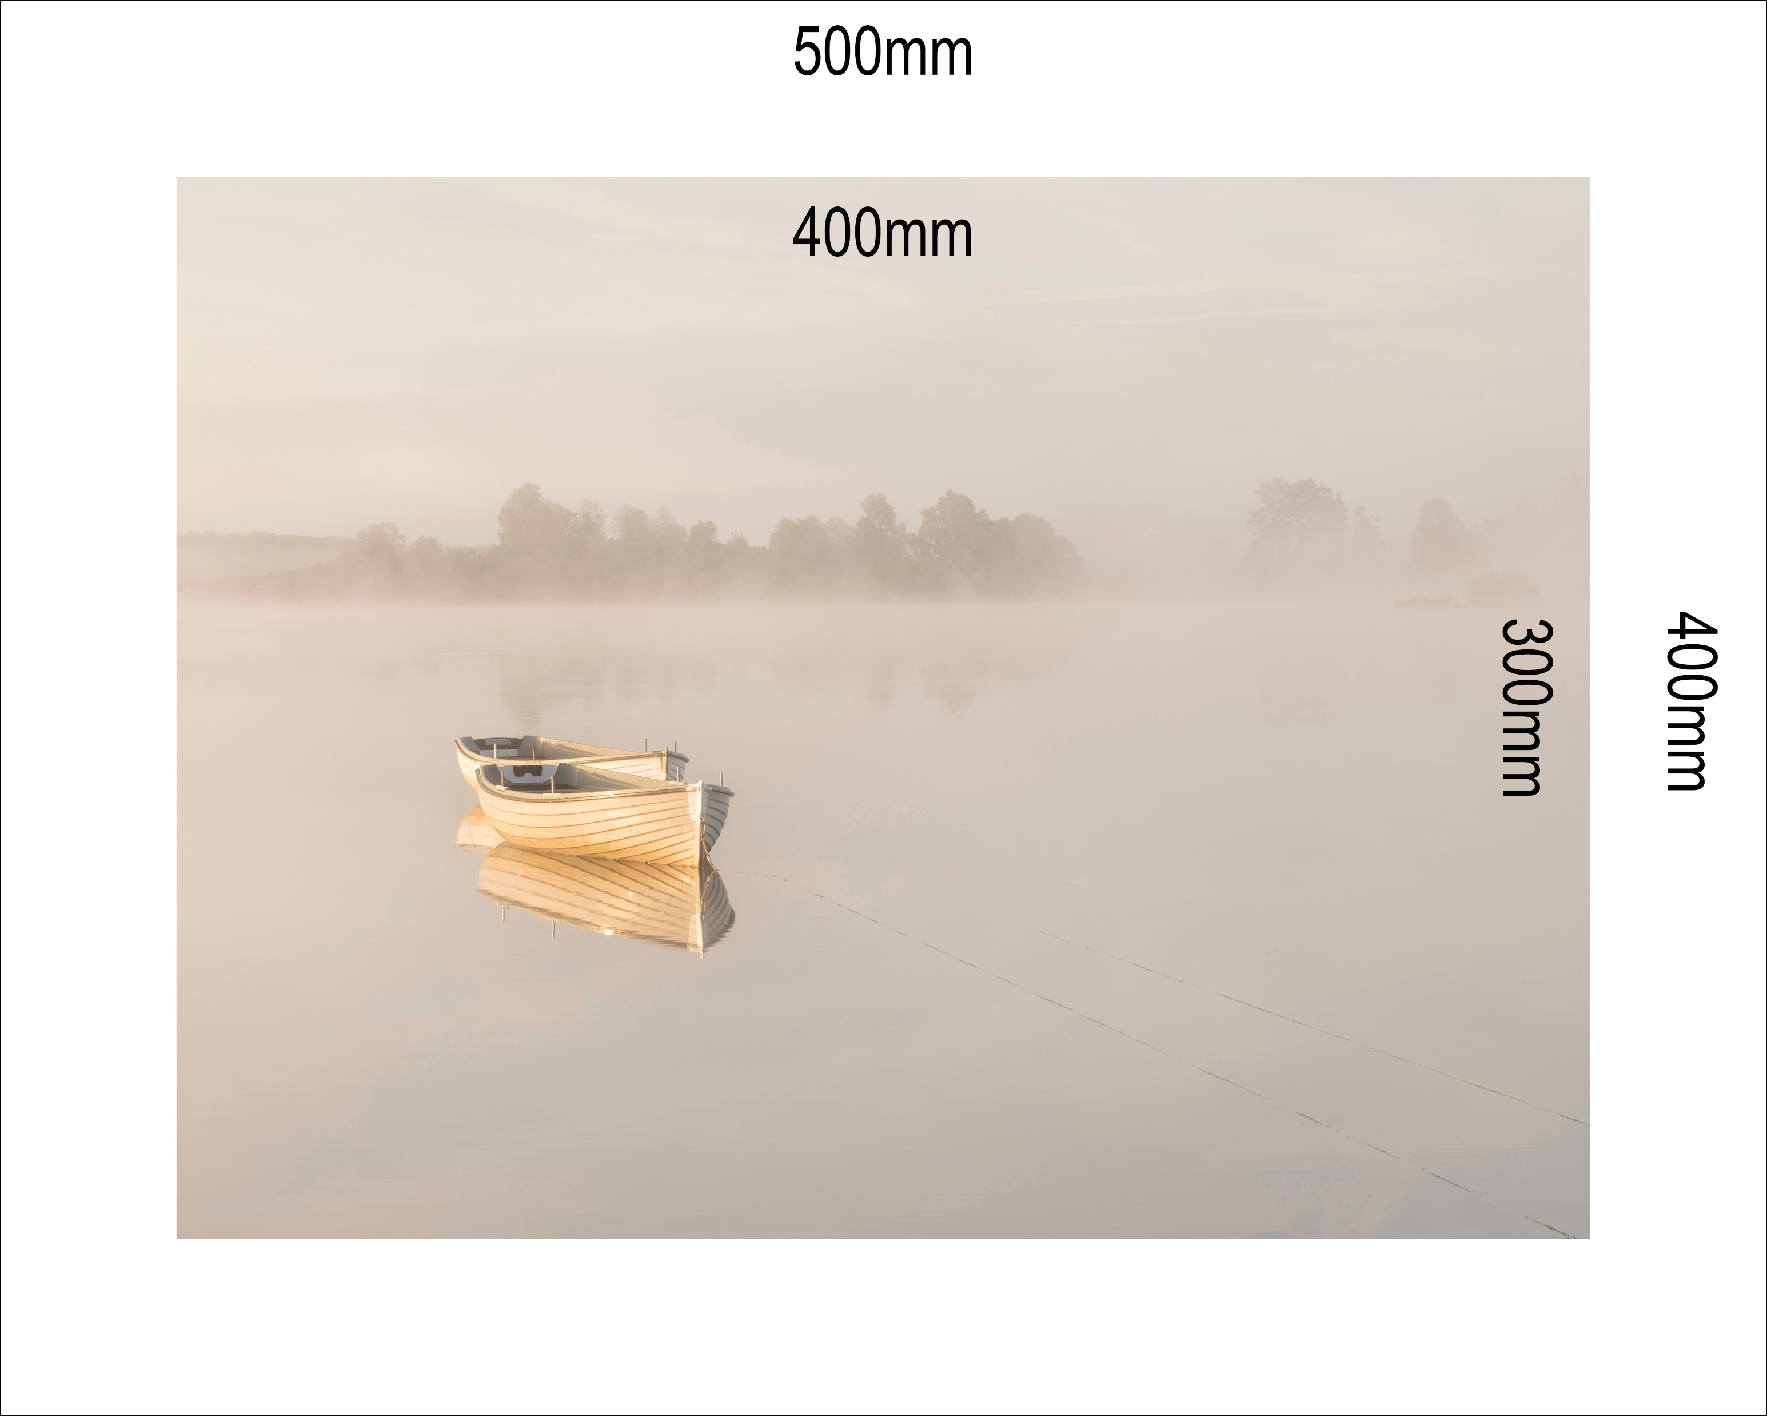
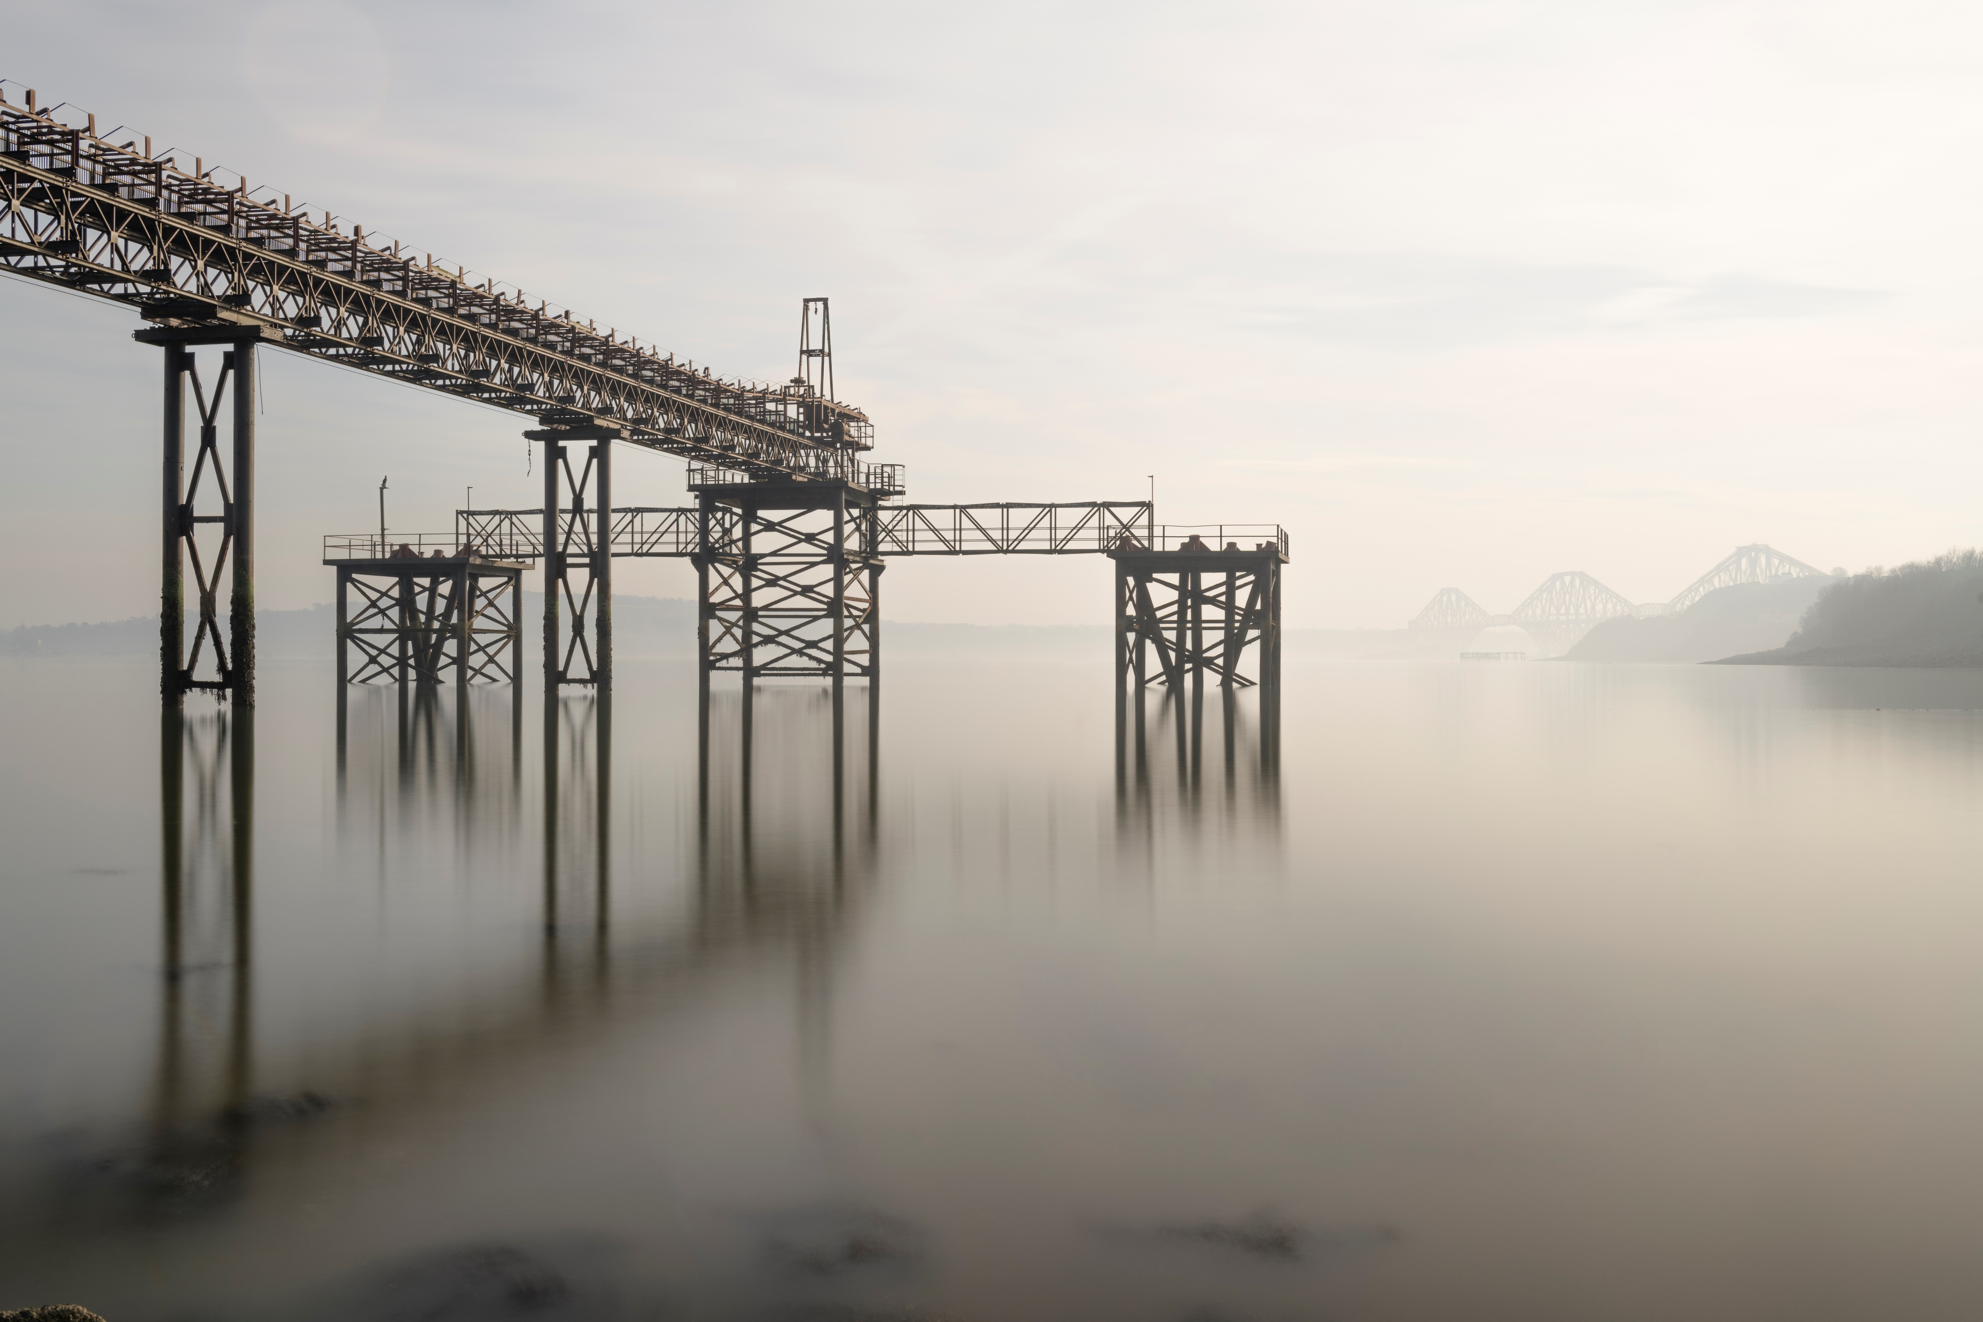
Mount to print – The easy way
Start with the image and decide what ratio suits best for the look you want. This should, in a perfect world be decided when you shot the image.
Decide on your image size based on an even border on the mount board you will use.
A 500x400 board with 400x300mm image is a nice even 50mm border all round.
Demo in Photoshop –
Visualise Mount

Slide 6
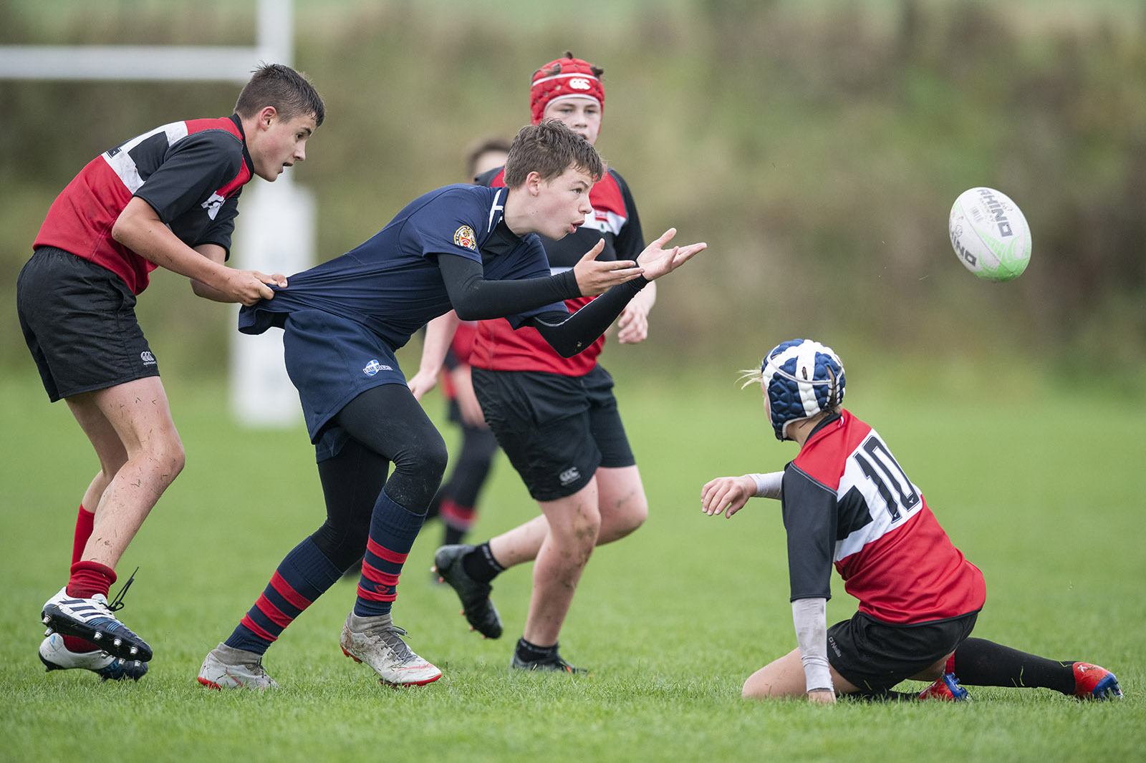
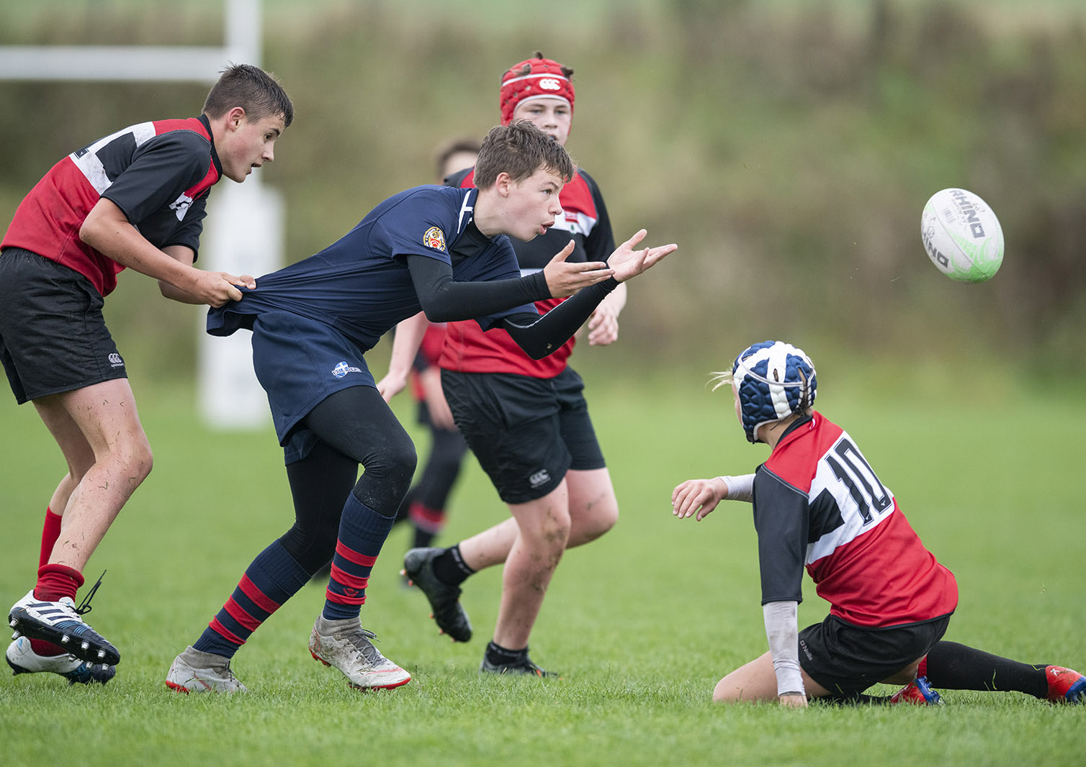
The Chicken way – Print to the mount
Convenience against excellence
Here we have a 3:2 ratio image.
This is the sensor size for most DSLRs and
mirrorless cameras Micro four Thirds being
the obvious exception with a 4:3 ratio
If we choose to use a standard A4 or A3 mount we are making our hard won image worse.

Slide 7
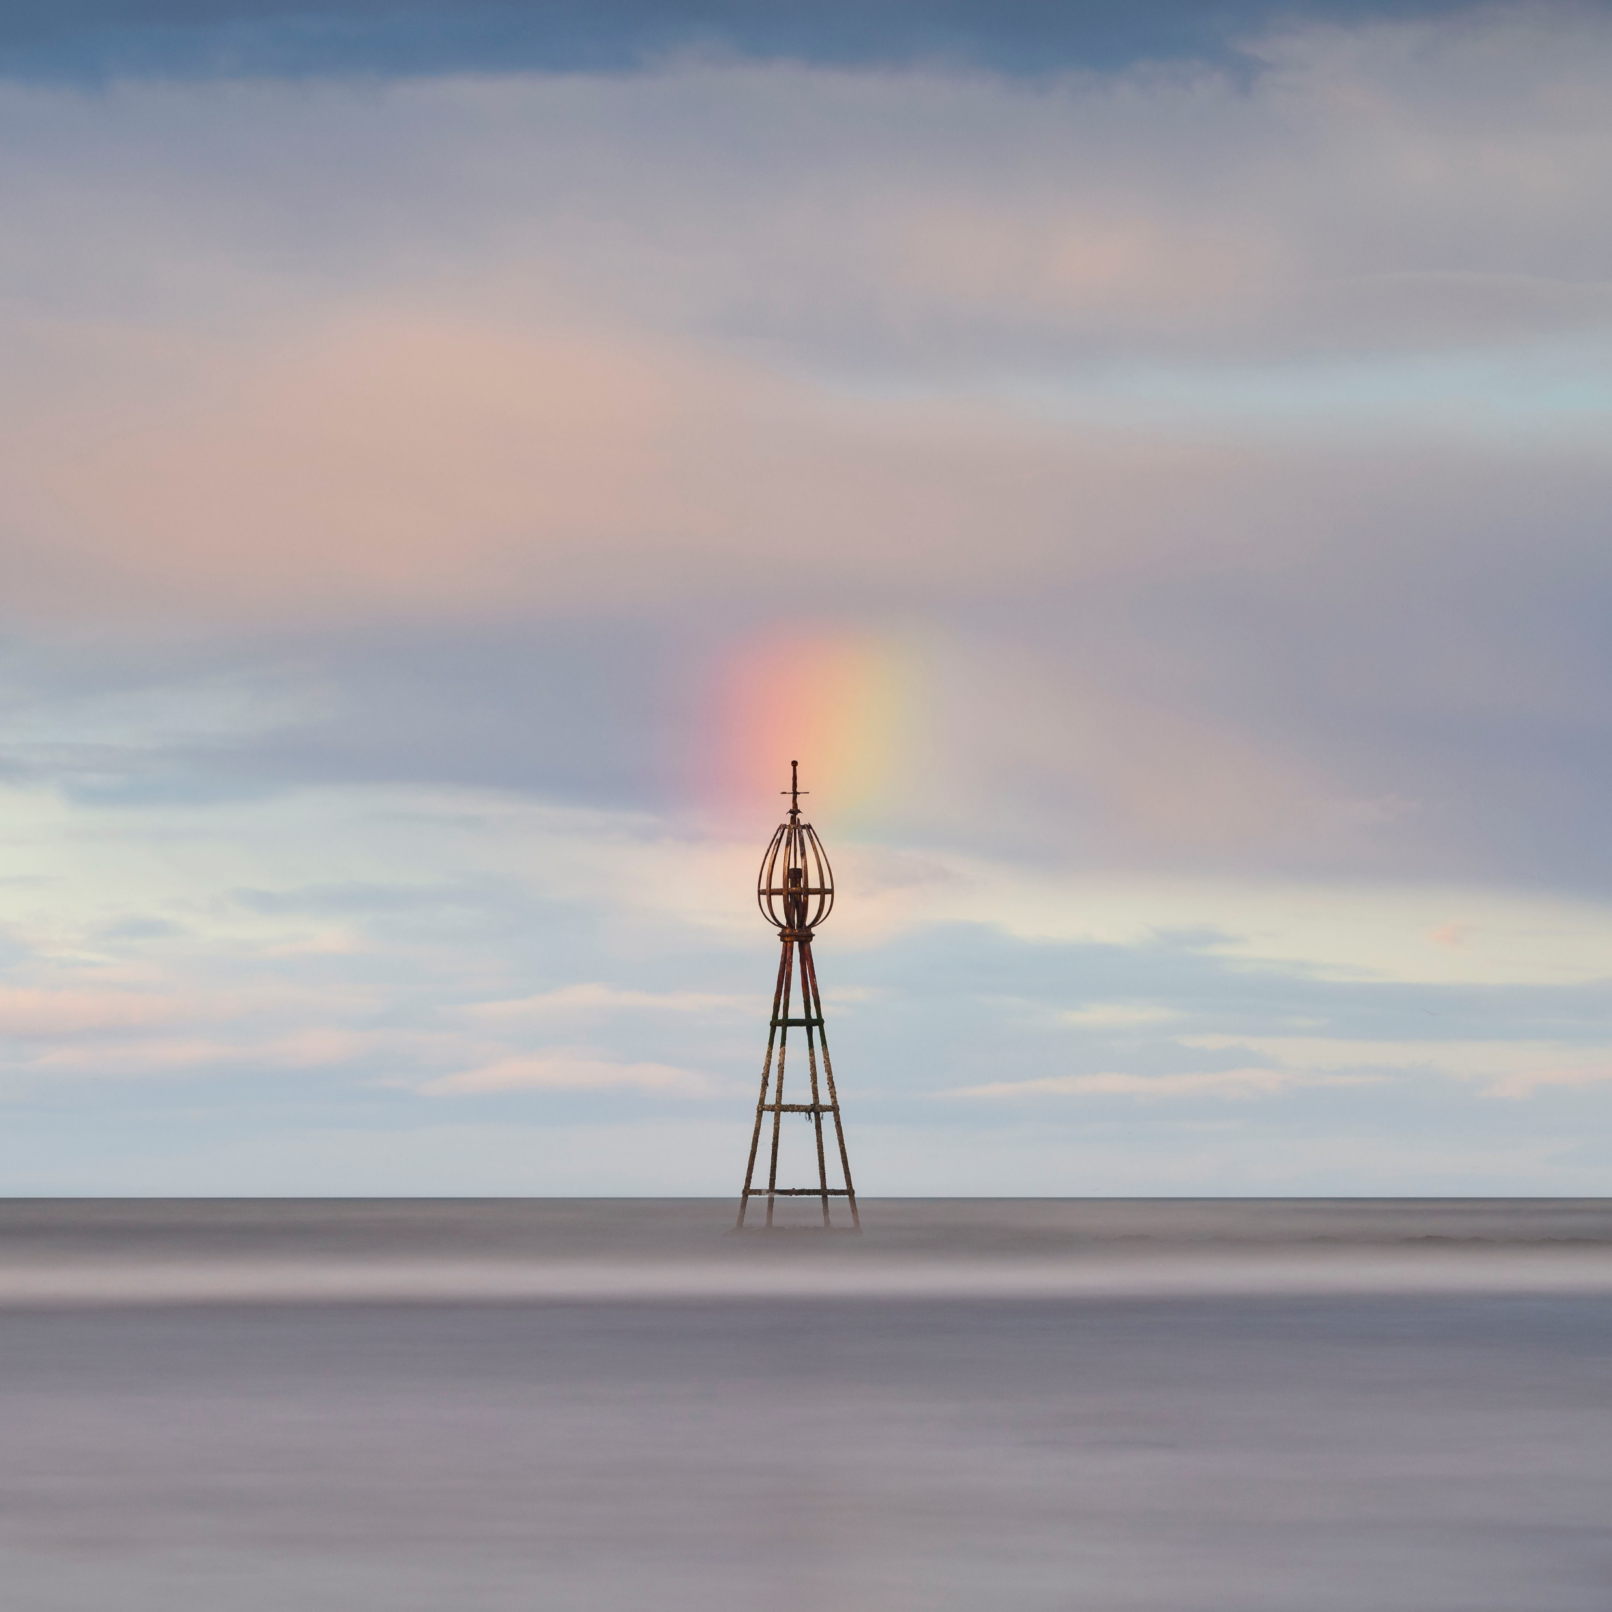
Getting the digital Image Ready Print to fit Mount – Shape/Ratio and dimensions
The club mounts come in three sizes. The square size is 8x8” aperture

Slide 8
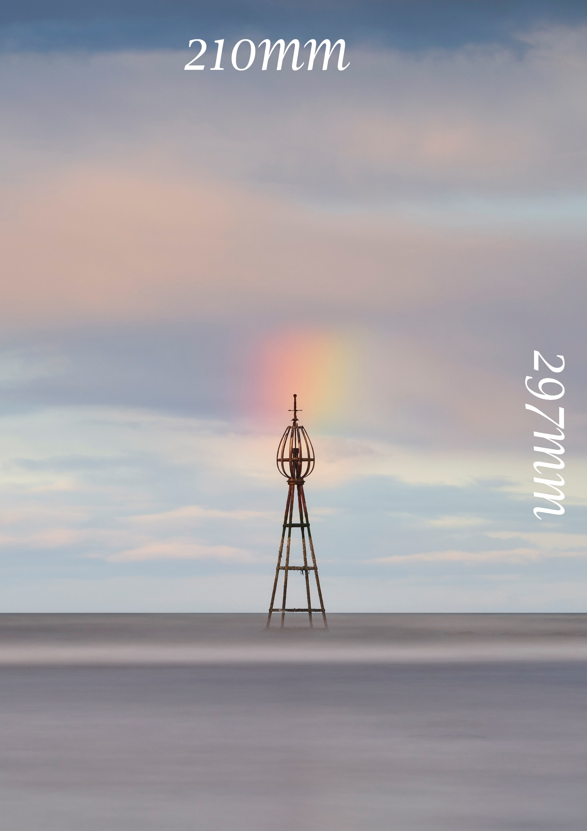
Getting the digital Image Ready Print to fit Mount – Shape/Ratio and dimensions
A4 – 297x210mm very approx

Slide 9
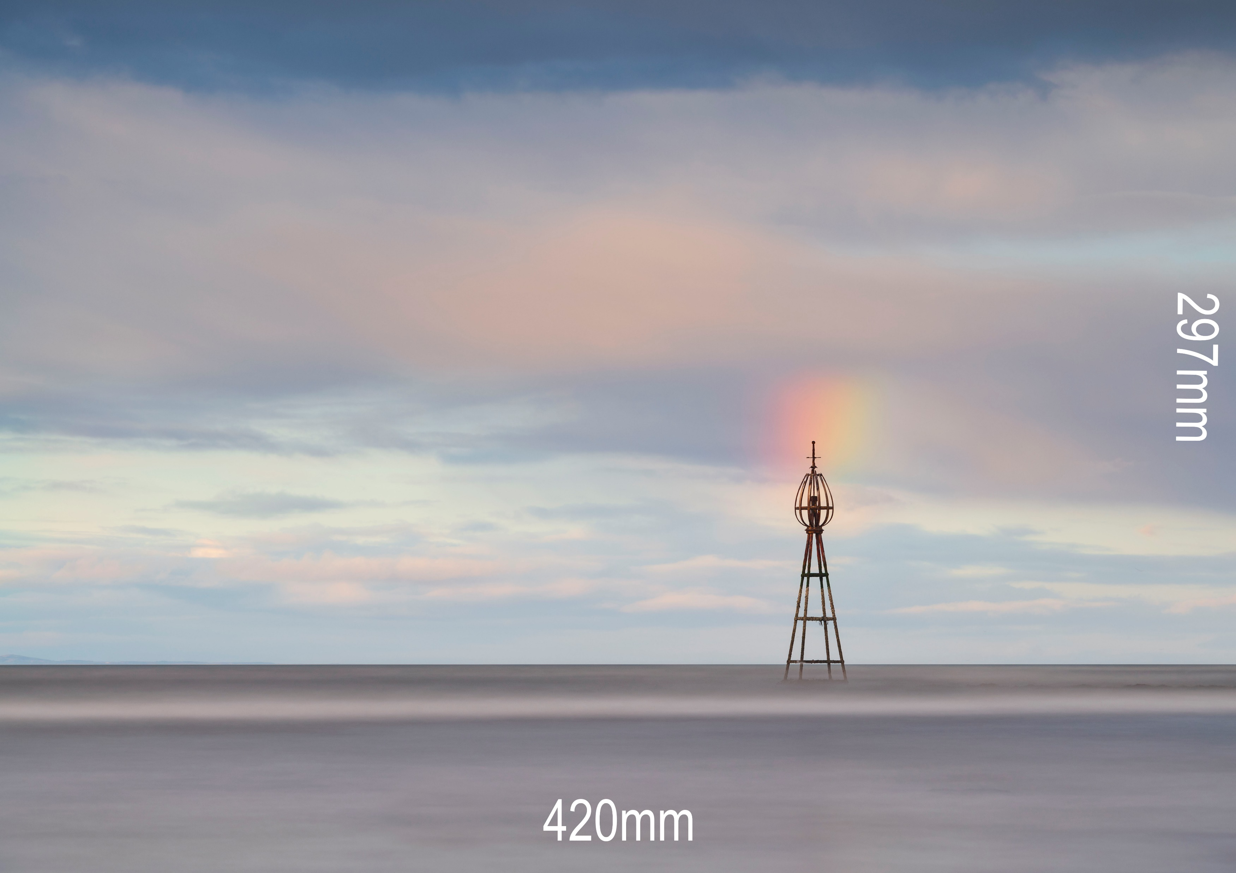
Getting the digital Image Ready Print to fit Mount – Shape/Ratio and dimensions
A3 – 420x297mm very approx

Slide 10
The Chicken way – How
Crop the image in photoshop to the club mount sizes, in this case A4, or any custom mount you have previously used and send to print.
You may have to choose the size of print up eg. 12x10 if you are getting Costco etc to print as A4 is often not full bleed. That can cause issues with an undersize print with a bigger aperture on the mount.
Demo in Photoshop - Presets

Slide 11
Tips, Tricks and reminders
A few MM rarely harms and image and makes mounting much easier
A stroke on the edge of an image can make mounting easier particularly if it has white areas.
Remember that sacrificial board when bevel cutting
Blades are cheaper than boards
Those blades are razor sharp and they will cut you if you are not careful
Don’t use the backing board if buying club mounts as a backing board. Cut a new board with it – sorry treasurer
Use photoshop to see what your mount will look like – size and colour

